Slide 1
Angular 2 & the CLI
By Isaac Martinez

Slide 2
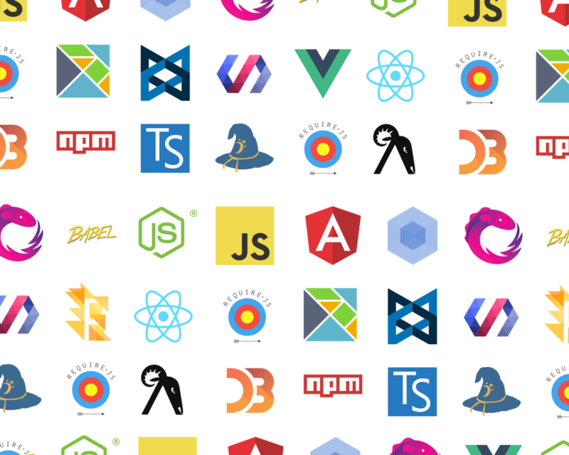
Learning JavaScript in 2016

Slide 3
Glossary of terms
NPM – A package manager similar to NuGet or Bower
https://www.npmjs.com/
TypeScript – A language that provides compile time safety checks and transpiles code to JavaScript https://www.typescriptlang.org/
Node.Js – Server and client JavaScript environment similar to .net Framework. https://nodejs.org/en/

Slide 4
THE Angular 2 quick start
git clone https://github.com/angular/quickstart.git quickstart
cd quickstart
npm install
npm start

Slide 5
QUICK START DEMO

Slide 6
Installing the angular2 cli
npm install -g angular-cli
Requires Node.Js to be installed https://nodejs.org/en/

Slide 7
Getting Start With CLI
ng init --name MyFirstAngularCliApp --style=less
Scaffolds Angular 2 project
Downloads packages from NPM
Sets up project to use Less (Sass/Scss and plain CSS are also options)
Sets up project for AOT (Ahead of Time) compilation
Sets up project for unit and e2e (End To End) testing
Sets up a development environment using Node.Js and BrowserSync

Slide 8
STEP 1: CLI INIT Demo

Slide 9
Components
ng g component my-1st-com
Kinda-sorta like a user control in ASPX or a partial view in MVC
This concept is not native to Angular 2 other Js frameworks use it
Has a selector that gives you control on where to render the component
Has html like markup
Has an isolated vendor prefixed CSS/LESS support built in

Slide 10
STEP 2: Component demo

Slide 11
Step 3: Component Nesting

Slide 12
STEP 4: CLI Code generation
ng g interface IBlog ng g service Blogs
The CLI supports generation of
Components
Directives
Pipes
Services
Classes
Interfaces
Enums
Modules

Slide 13
Step 4: Demo

Slide 14
STEP 5: Prepare project for RESTFUL Data
We’ll be connecting to https://derivewebnode.azurewebsites.net/api/blogs restful service. This service is hosted on Azure running Node.Js.
Use json2ts to extend the IBlog interface to reflect rest service data.
Setup BlogService as a provider
Setup constructor so that BlogService is injected

Slide 15
Step 5: Demo

Slide 16
STEP 6: Extend The Blog Service
Inject the Http Provider
Create “Get” method to return either a Promise<iBlog[]>.
Use the Http provider to execute Http Get.
You can also use Reactive Extensions to return an Observable<Array<iblog>>

Slide 17
Step 6: Demo

Slide 18
Step 7: Setup HTML Binding
In ngOnInit() call the blog service and push the data to highlighted blogs and regularblogs
Using Angular binding, create HTML table to render data.

Slide 19
Step 7: Demo

Slide 20
Step 8: Add BootStrap
npm install --save-dev bootstrap jquery
Add the relevant script and styles to the angular-cli.json file.
Bootstrap the component
Add a container div
Apply row, col and attribute classes accordingly.

Slide 21
Step 8: Demo

Slide 22
References
Angular 2 Docs https://angular.io/docs/ts/latest/
Angular CLI https://github.com/angular/angular-cli
Angular 2 Tour of Heroes https://angular.io/docs/ts/latest/tutorial/
TypeScript Tutorial https://www.typescriptlang.org/docs/tutorial.html
Less Tutorial http://lesscss.org

